Slide 1

World Wide Energy Consumption Analysis

Slide 2
About me
About me Background
I am a 3rd-year B.Tech student pursuing Computer Science Engineering.
Why you want to learn Data Science
I want to learn Data Science to develop strong skills in data analysis, visualization, and problem-solving using real-world data. As a computer science student, I am interested in data-driven decision-making and aim to pursue a career in data-related roles.
Any work experience
Fresher with hands-on experience in Excel, EDA and SQL-based data analysis projects, with a strong interest in data analytics roles.
LinkedIn : https://www.linkedin.com/in/sanjanagorli/
GitHub : https://github.com/Sanju0714

Slide 3
Objective of the Project
To analyze global energy production, consumption, and emission data.
To study the relationship between GDP and energy growth.
To examine how population affects energy usage and emissions.
To calculate per capita and efficiency metrics (Emission-to-GDP ratio).
To identify trends and improvements in environmental performance across countries.

Slide 4
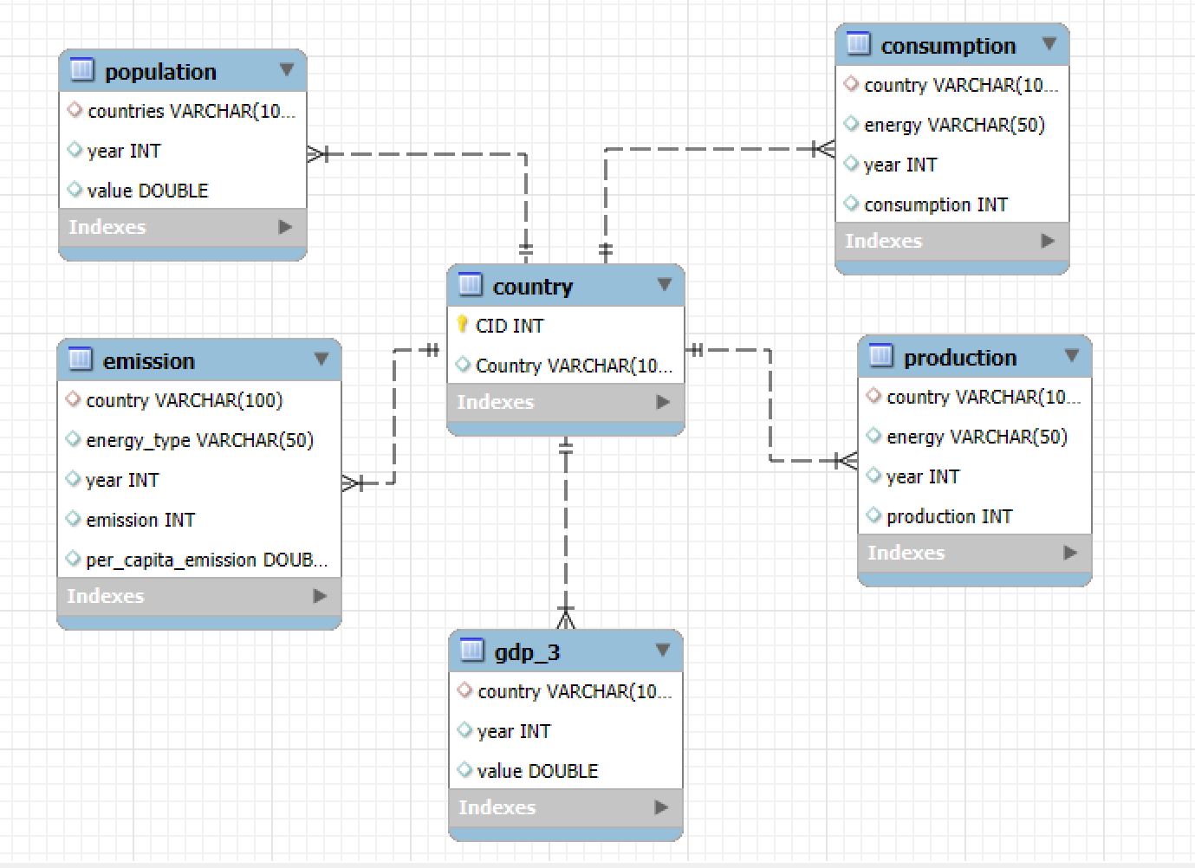
ER Diagram and schema explanation
Database Design Overview
The database is designed to analyze global energy, GDP, population, and emission data.
The Country table acts as the central (master) table.
All other tables are connected through one-to-many relationships.

Slide 5
Country Table (Master Table)
Primary Key: CID
Stores unique country names.
Ensures data consistency across all related tables.
Population Table
Stores yearly population data.
One country can have multiple population records (year-wise).
Emission Table
Stores emission data by energy type and year.
Includes per capita emission.
Used for environmental trend analysis.
Production Table
Stores energy production data by country and year.
Helps analyze energy supply trends.

Slide 6
Consumption Table
Stores energy consumption data by country and year.
Used to study demand patterns.
GDP Table
Stores yearly GDP data for each country.
Used to analyze economic growth.
Relationship Structure
One Country → Many Records in all other tables.
Ensures:
Data integrity
No duplication
Efficient joins for analysis

Slide 7
Key analysis questions (use cases)
What are the top 5 countries by GDP in the most recent year?
How have global emissions changed year over year?
Which energy types contribute most to emissions across all countries?
Has energy consumption increased or decreased over the years for major economies?
What is the global share (%) of emissions by country?
What is the global average GDP, emission, and population by year?

Slide 8
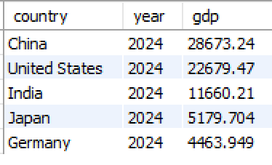
What are the top 5 countries by GDP in the most recent year?
Key Insight
China has the highest GDP in 2024.
The United States follows closely.
India ranks third among global economies.
These five countries dominate global economic output

Slide 9
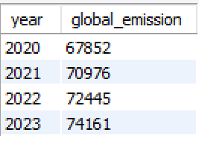
How have global emissions changed year over year?
Key Insight
Global emissions show an overall increasing trend over the years.
Some years may show slight dips due to economic slowdown or policy changes.
Growth in industrial activity is directly reflected in emission increase.

Slide 10
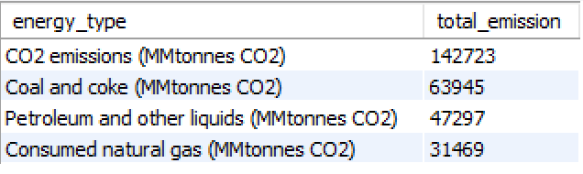
Which energy types contribute most to emissions across all countries?
Key Insight
Total CO₂ emissions are highest overall.
Coal is the largest fossil fuel contributor.
Petroleum and natural gas also contribute significantly.
Fossil fuels dominate global emissions.

Slide 11
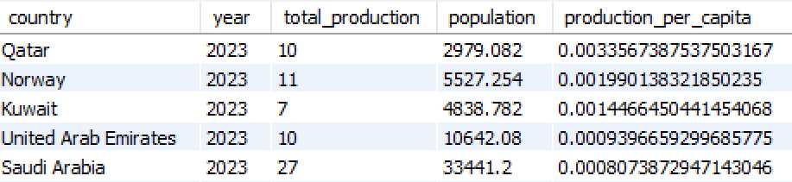
Has energy consumption increased or decreased over the years for major economies?
Key Insight
Qatar ranks highest in energy production per capita.
Norway and Kuwait also show strong per capita production levels.
UAE and Saudi Arabia complete the top five.
High per capita production is common in energy-rich, smaller population countries.

Slide 12
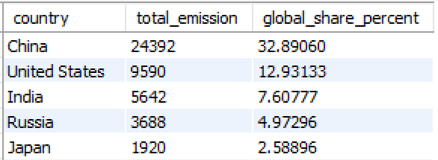
What is the global share (%) of emissions by country?
Key Insight
China contributes the highest share of global emissions (32.89%).
The United States and India follow as major contributors.
Russia and Japan also hold significant shares.
Together, the top five countries contribute nearly 60% of global emissions, accounting for about half of the total emissions worldwide.

Slide 13
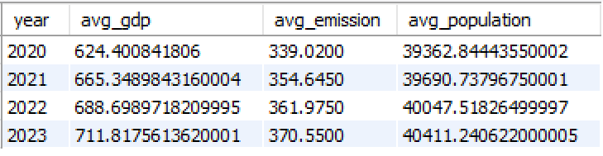
What is the global average GDP, emission, and population by year?
Key Insight
The global average GDP has steadily increased from 2020 to 2023.
The global average emission has also shown a consistent upward trend.
The average population increased gradually over the years.
Economic growth appears to be associated with rising emission levels.

Slide 14
Final business insights and recommendations
Final Business Insights
Economic growth is strongly linked with rising energy consumption and emissions.
Fossil fuels (especially coal and petroleum) remain the dominant sources of emissions.
A small number of countries contribute nearly half of global emissions.
Emerging economies show rapidly increasing energy demand.
Developed economies show relatively stable or improving emission efficiency.
Recommendations
Increase investment in renewable energy sources to reduce fossil fuel dependency.
Improve energy efficiency to lower emission-to-GDP ratios.
Promote clean technology adoption in high-emission countries.
Encourage sustainable industrial growth in emerging economies.
Strengthen international collaboration to reduce global emissions collectively.

Slide 15
Conclusion (Key finding overall)
Global economic growth has been accompanied by a steady rise in energy production and consumption.
Emissions remain highly concentrated among a few major economies.
Fossil fuels continue to be the dominant source of global carbon emissions.
Per capita and ratio analysis reveals differences in energy efficiency across countries.
Data-driven analysis helps identify patterns linking population, GDP, and environmental impact.

Slide 16
Experience & Challenges – SQL Data Analysis Project
Experience
Gained hands-on experience in advanced SQL queries.
Strengthened skills in joins, subqueries, and window functions.
Analyzed real-world datasets to extract meaningful insights.
Improved problem-solving and analytical thinking.
Challenges Faced
Managing multi-table relationships and joins.
Debugging complex queries and window functions.
Handling large datasets and summarizing results.
Ensuring accurate aggregations and interpretations.

Slide 17
Any Questions
You are Welcome!

Slide 18

THANK YOU

